Slide 1
ELASTIC CLOUD COMPUTE
VIKAS
Notes:
Aws account set up
https://aws.amazon.com/about-aws/global-infrastructure/

Slide 2
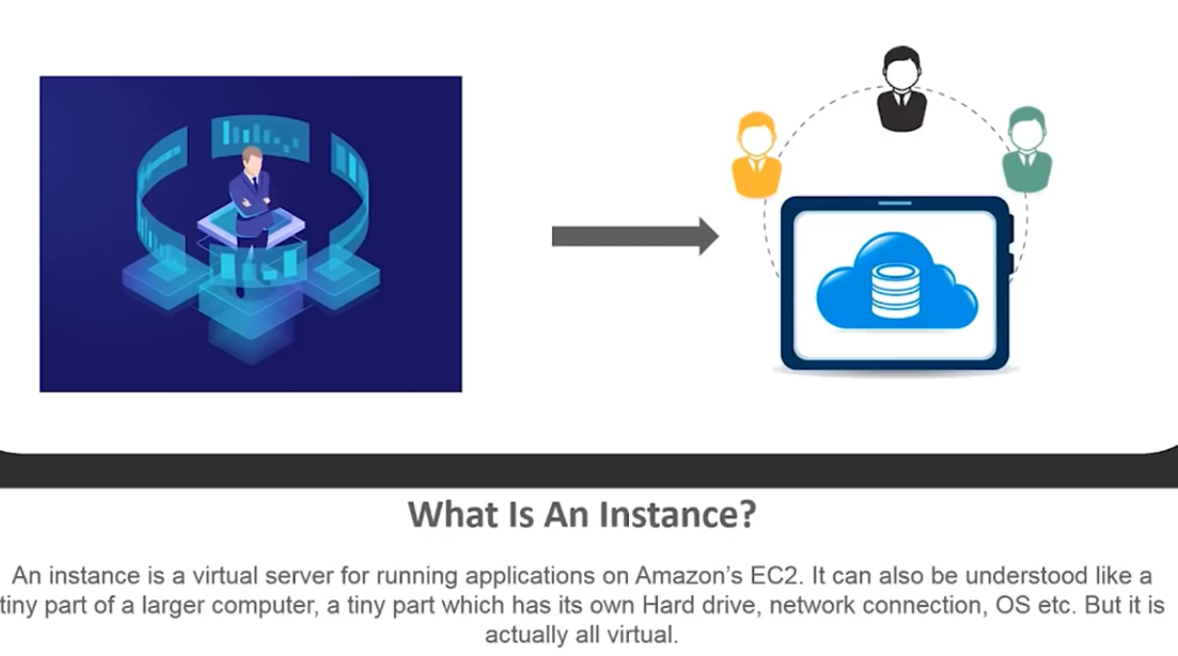
Notes:
Benefits of EC2 :
---------
beat machine dependency
Scalable
Flexible
Cost effective

Slide 3
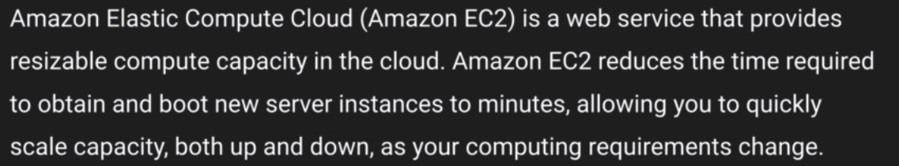
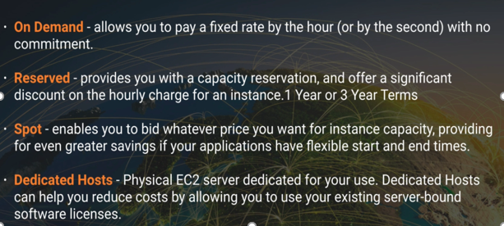
Notes:
All instance type can be remembered as “FIGHTDRMCPX”
If a Spot instance is terminated by AWS you will not be charged any thing but f you do it you will be charged for that hour .
Boot strap script :
--------------------
#!/bin/bash
yum update –y ➔ to install latest OS
yum install httpd –y ➔ to install apache which turns EC2 to a web server
service httpd start ➔ start service
chkconfig httpd on ➔ if EC2 reboots apache server comes up automatically
cd /var/www/html ➔ whatever you put here will act like a website
Curl http://169.254.169.254/latest/user–data ==> show you the bash script ran .
Yum install –y amazon-efs-utils ➔ mount efs volumes
Copy S3 bucket content to s3 :
===================
aws s3 sync s3://<bucket name> /var/www/html

Slide 4
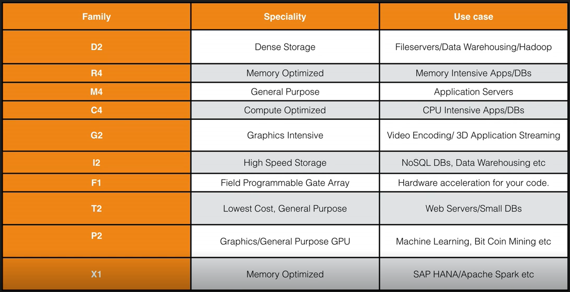
EC2 Instance types :
Notes:
EC2 Instance Types – Main ones
• R: applications that needs a lot of RAM – in-memory caches
• C: applications that needs good CPU – compute / databases
• M: applications that are balanced (think “medium”) – general / web app
• I: applications that need good local I/O (instance storage) – databases
• G: applications that need a GPU – video rendering / machine learning
• T2 / T3: burstable instances (up to a capacity)
• T2 / T3 - unlimited: unlimited burst
• Real-world tip: use https://www.ec2instances.info
#!/bin/bash
yum update -y
yum install -y httpd
systemctl start httpd
systemctl enable httpd
echo “<h1>Hello World from $(hostname -f)</h1>” > /var/www/html/index.html

Slide 5
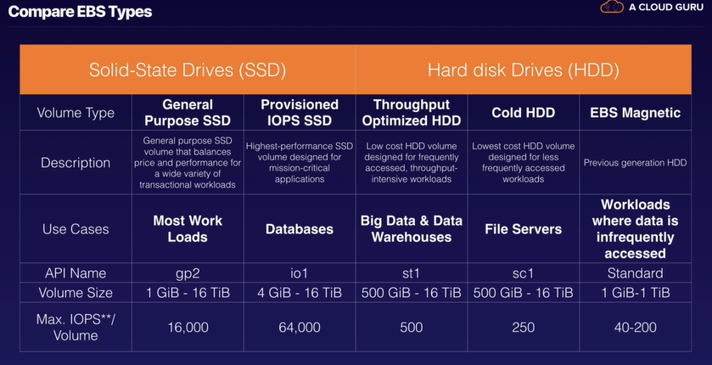
Notes:
SDD are 2 types :
General purpose – balanced price and performance with a wide variety of work load . It is not suitable for frequently accessed, throughput-intensive workloads.
Provisioned IOPS – Highest performance SSD volumes for highly critical ,low latency & high through put work load . Is not the most cost-effective but primarily used for critical business applications that require high performance.
HDD :
Throughput optimized HDD – Low cost HDD volumes for frequently accessed throughput intensive workload .
Cold HDD – Lowest cost HDD for less accessed workload .
Magnetic – previous generation .Can’t be used for boot volume .

Slide 6
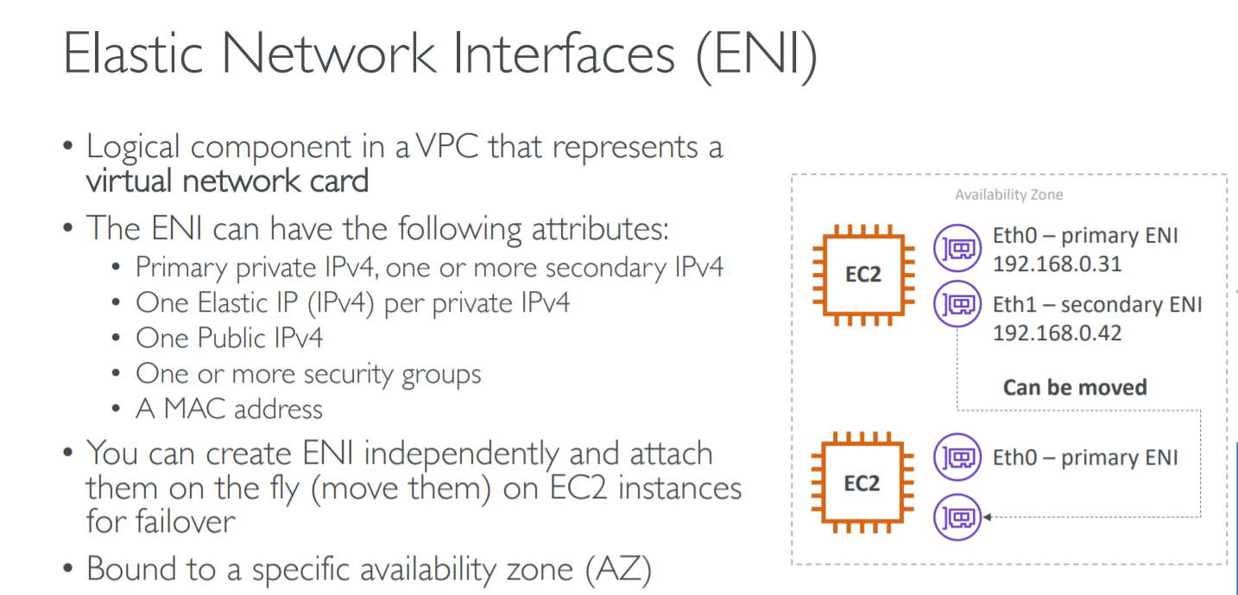

Slide 7
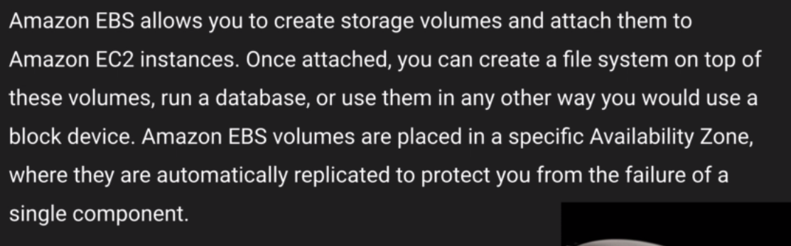
EBS & EBS volume types
Notes:
If you see EC2 as a server EBS is a virtual boot disk .You can create storage volumes and attach it to EC2 then attach a file system .This will allow you to run DB or any other application .EBS volume where OS is installed is called root volume and then you can have other volume .Like C drive and D drive .
EBS can’t be shared across EC2 instead use EFS .
Instance Store Backed is also called Eephemral storage . This can’t be stopped and if underlying host fails you lose the data .but it is totally different in EBS .
On rebooting both you don’t looses your data .
On termination of instance both are deleted but for EBS you can exclusively ask to retain it .
AMI are regional in nature .You can launch an AMI from the region where it is stored .However AMI can be copied from one region to another .

Slide 8
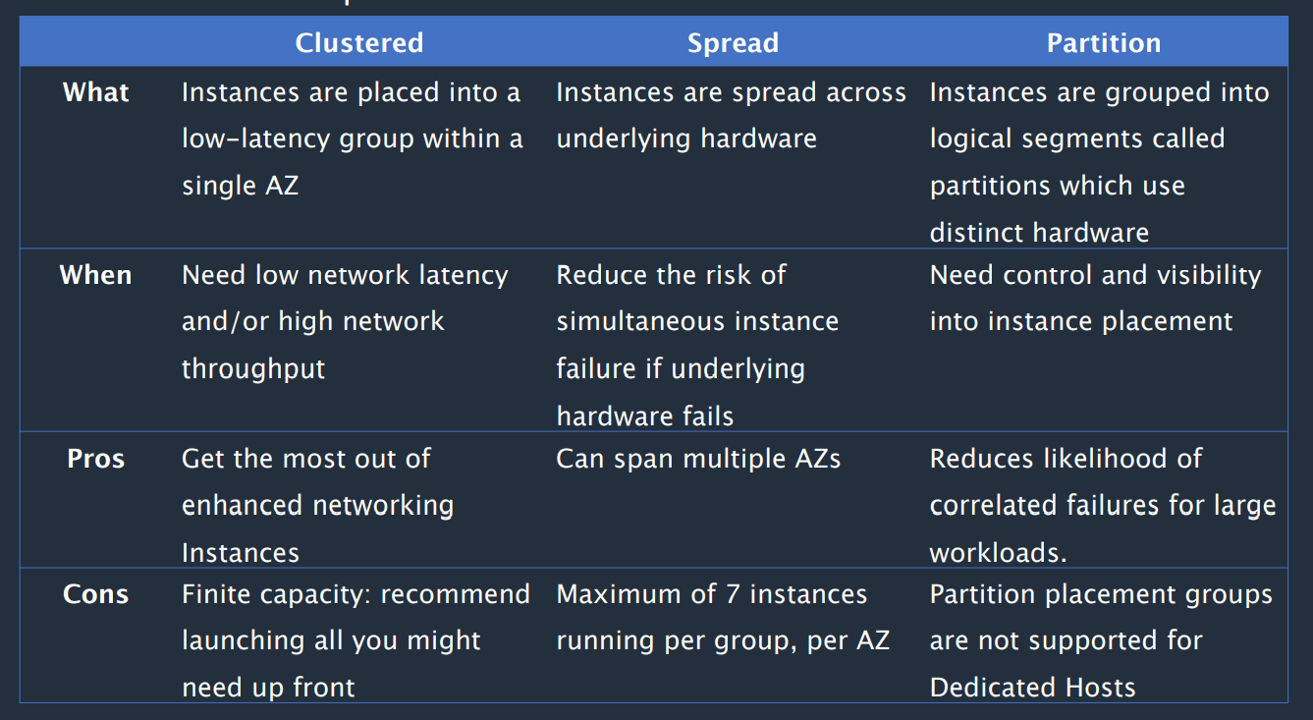
Notes:
Placement Groups - Sometimes you want control over the EC2 Instance placement strategy
Cluster – packs instances close together inside an Availability Zone. This strategy enables workloads to achieve the low-latency network performance necessary for tightly-coupled node-to-node communication that is typical of HPC applications. clusters instances into a low-latency group in a single Availability Zone
Partition – spreads your instances across logical partitions such that groups of instances in one partition do not share the underlying hardware with groups of instances in different partitions. This strategy is typically used by large distributed and replicated workloads, such as Hadoop, Cassandra, and Kafka. Spread—spreads instances across underlying hardware (max 7 instances per group per AZ)
Spread – strictly places a small group of instances across distinct underlying hardware to reduce correlated failures. Partition—spreads instances across many different partitions (which rely on different sets of racks) within an AZ. Scales to 100s of EC2 instances per group (Hadoop, Cassandra, Kafka)
1 EBS Volume can be not shared with multiple EC2 Instance but if such a need arises, we use EFS .

Slide 9
EBS Volumes :
EC2 instance and all the EBS volumes must be in the same AZ (Mandatory from AWS ) .
Root volumes can be identified by snapshots (AMI- Root device volume) whereas other additional volumes will not have snapshot .
Here if you want to modify root volume yes you can change without stopping the instance and the changes will reflect immediately .
You can modify volumes for all apart from standard magnetic ones .
Snapshots are taken for backup(Snap shot Tab) and Images are taken for creating a new EC2 (AMI Tab).
When you terminate the instance root volume will be deregistered bit not the other additional volume .You have to do it exclusively .
Snap shots exists on S3 but not visible to user .This is incremental in nature means only changes are copied .
Snapshots can be taken when instance is running but it’s advised to stop them .
EBS Volumes can changed on the fly without stopping them .
Notes:
Steps to create a new EC2 instance/Volume in another AZ
Take a snapshot of EC2 instance and name it .
Goto Snap shot tab -> Create volume /Create Image -> here you can change volume type, AZ , Encryption .
You can copy the snap shot to new region and encrypt if needed then create an image and boot from that new region .
Snapshots of encrypted volumes are encrypted automatically .Also volume restored from encrypted snapshots are encrypted automatically .
Snapshots can be shared only if they are unencrypted . Can be used with other accounts and made public .
Snapshots of volumes resides on S3 .First snapshot may take some time .

Slide 10
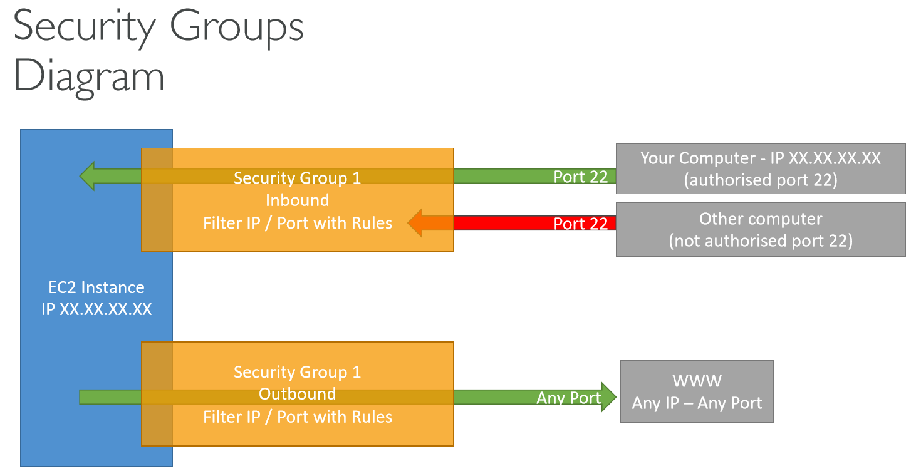
Notes:
Question : Can you delete the snapshot of EBS volume that is used as a root device of a registered AMI ?
You must deregister a AMI before being able to delete the root device
When you launch an instance in a VPC, you can assign up to five security groups to the instance. Security groups act at the instance level, not the subnet level. Therefore, each instance in a subnet in your VPC could be assigned to a different set of security groups. If you don't specify a particular group at launch time, the instance is automatically assigned to the default security group for the VPC.
ECS is a container orchestration service that supports Docker containers for you to run containerized services. It is not serverless since you will still be managing the docker containers yourself. Amazon EC2 Container Service (ECS) is a cloud computing service in Amazon Web Services (AWS) that manages containers. It enables developers to deploy and manage scalable applications that run on groups of servers called clusters through application programming interface (API) calls and task definitions.
It’s a virtual firewall which controls the to and fro movement of item in EC2 .It is the first line of defense .
One instance can be associated with multiple security group .
One security group can also be associated to multiple Instance .
Any rule change made to security group will reflect immediately .
Security groups are state full means when you give inbound rule outbound rues are automatically updated whereas Network Access Control List is state less .
Security Groups are the fundamental of network security in AWS • They control how traffic is allowed into or out of our EC2 Instances.
You can’t deny any traffic group

Slide 11
Boot strap script :
#!/bin/bash
yum update -y
yum install httpd24 php56 git -y
service httpd start
chkconfig httpd on
cd /var/www/html
echo "<?php phpinfo();?>" > test.php
git clone https://github.com/acloudguru/s3
Notes:
#!/bin/bash
yum install httpd
service httpd start
systemctl enable httpd
cd /var/www/html
echo "<html><h1> My website on AWS from script </h1></html>" >> index.html
sudo amazon-linux-extras install epel -y
sudo yum install stress -y
stress -c 8
yum repolist
yum list installed
yum grouplist
tail -5 /var/log/yum.log
yum history
yum search java
#!/bin/bash
yum update -y
yum install httpd -y
service httpd start
chkconfig httpd on
cd /var/www/html
echo "<html><h1>Hello Cloud Gurus Welcome To My Webpage</h1></html>" > index.html
echo "<html><h2>Hello Cloud from AWS </h2></html>" >> index.html
aws s3 mb s3://vikas-online-2301
aws s3 cp index.html s3://vikas-online-2301
curl http://169.254.169.254/latest/user-data
curl http://169.254.169.254/latest/meta-data
https://www.thegeekstuff.com/2019/04/aws-s3-cli-examples/

Slide 12
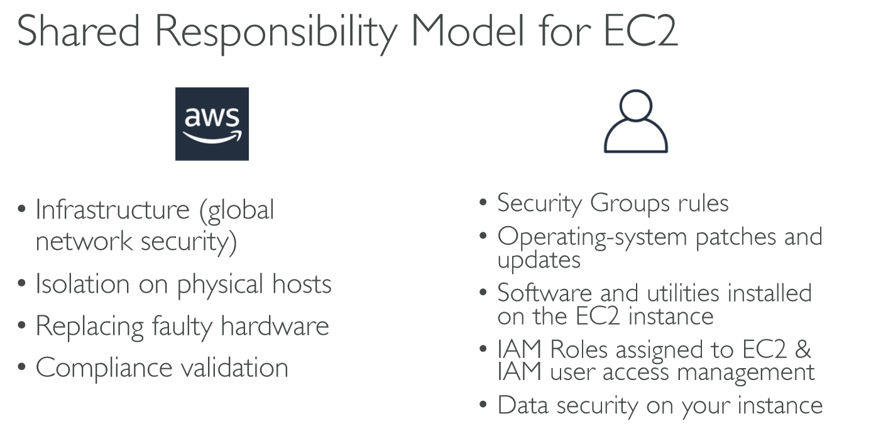
Notes:
1 clear
2 yum install httpd
3 service httpd status
4 service httpd start
5 service httpd status
6 clear
7 systemctl enable httpd
8 cd /var/www/html
9 nano index.html
10 cat index.html
11 nano index.html
12 clear
13 history
Networking has two sorts of IPs. IPv4 and IPv6:
• IPv4: 1.160.10.240
• IPv6: 3ffe:1900:4545:3:200:f8ff:fe21:67cf

Slide 13
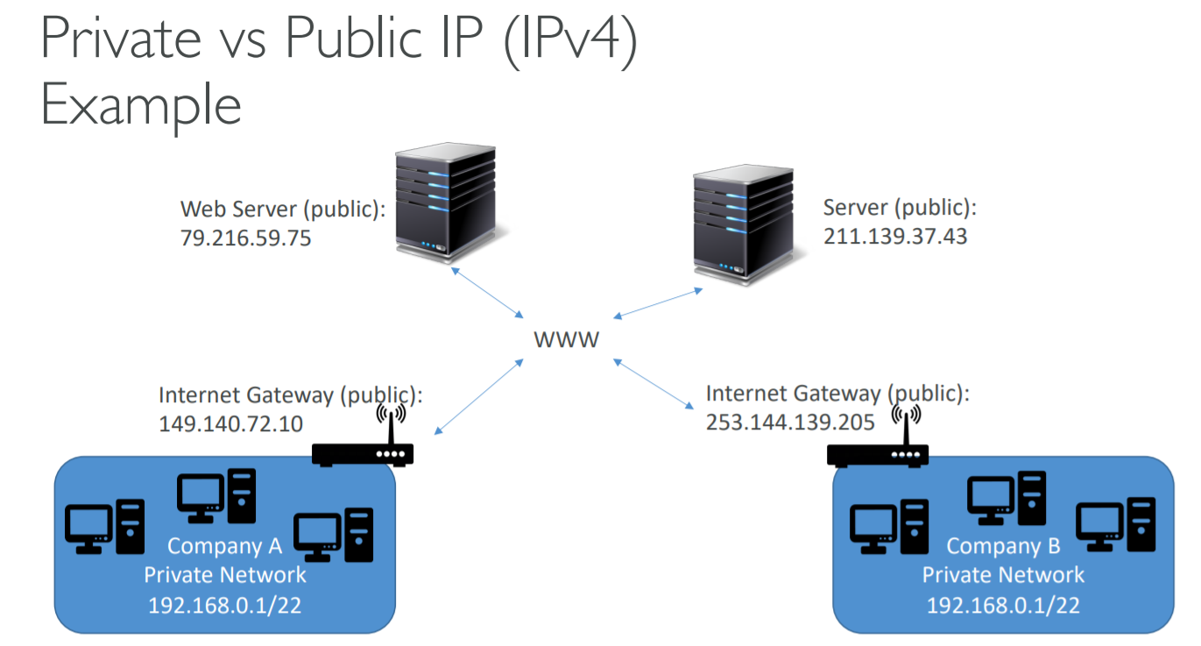
Notes:
Elastic IP
• With an Elastic IP address, you can mask the failure of an instance or software by rapidly remapping the address to another instance in your account.
• You can only have 5 Elastic IP in your account (you can ask AWS to increase that).

Slide 14
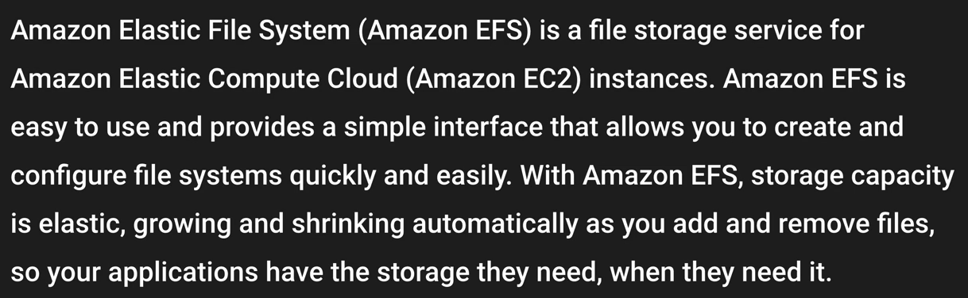
Notes:
Change to Default SG to accommodate NFS protocol on webDMZ.
#!/bin/bash
yum update -y
yum install httpd -y
service httpd start
chkconfig httpd on
yum install amazon-efs-utils –y
enable nfs on default SG ..
Once the instance is launced ..Connect to it via putty and mount using -- > mount –t efs –o tls fs-9816b269:/ /var/www/html from /var/www/ .. Create a file here inside html .
lsblk
mkfs –t ext4 /dev/xvdb
mkdir /testblock
mount /dev/xvdb /testblock
file –s /dev/xvdf
aws ec2 run-instances --image-id <> --count 1 --instance-type t2.micro --key-name <> --security-group-ids <> --subnet-id <>
aws ec2 describe-instances
aws ec2 terminate-instances --instance-ids <instance id >
aws s3 cp --recursive s3://<bucket-name> /home/ec2-user

Slide 15
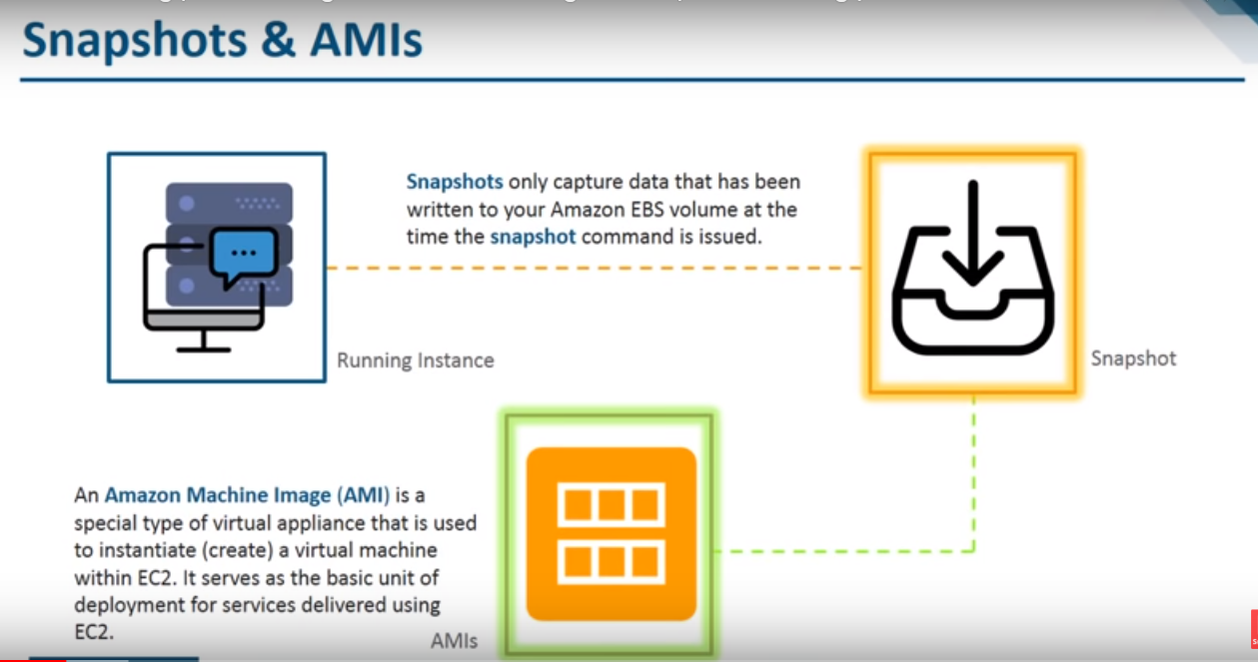
Notes:
Your company has decided to set up a new AWS account for test and dev purposes. They already use AWS for production, but would like a new account dedicated for test and dev so as to not accidentally break the production environment. You launch an exact replica of your production environment using a cloudformation template that your company uses in production. However cloudformation fails. You use the exact same CloudFormation template in production so the failure is something to do with your new AWS account. The CloudFormation template is trying to launch 60 new EC2 instances in a single availability zone. After some research you discover that the problem is; --. There is a soft limit of 20 instances per region. Submit the limit increase form and retry the failed requests once approved .

Slide 16
Notes:
Spot Fleets = set of Spot Instances + (optional) On-Demand Instances
• The Spot Fleet will try to meet the target capacity with price constraints
• Define possible launch pools: instance type (m5.large), OS, Availability Zone
• Can have multiple launch pools, so that the fleet can choose
• Spot Fleet stops launching instances when reaching capacity or max cost
• Strategies to allocate Spot Instances:
• lowestPrice: from the pool with the lowest price (cost optimization, short workload)
• diversified: distributed across all pools (great for availability, long workloads)
• capacityOptimized: pool with the optimal capacity for the number of instances

Slide 17
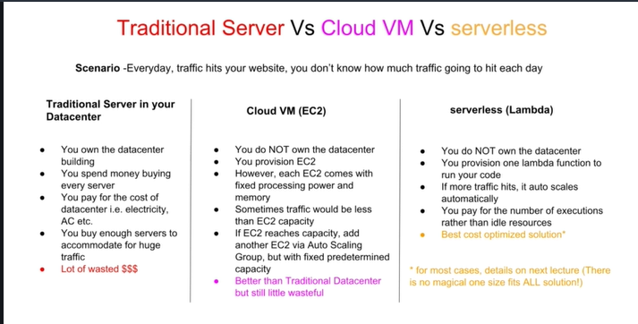

Slide 18

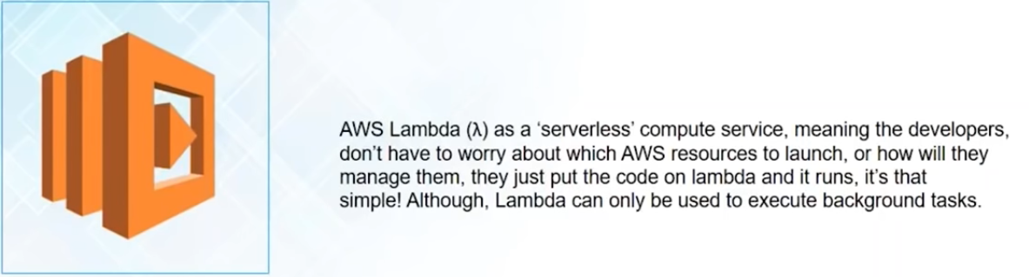
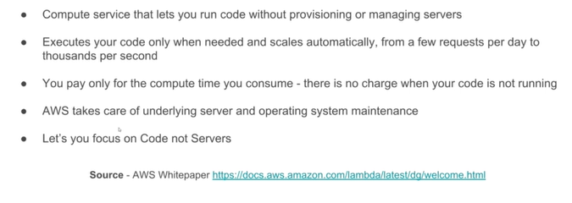
Notes:
Is a compute service where you can upload your code and create a Lambda function .
It takes care of provisioning and managing the servers that you use to run the code .You need not worry about OS ,patching ,scaling etc .
Quick and simple . Automated version of EC2 .
Scalable
Cost effective
Offers multi tenancy architecture – share your application in secured manner .
Server less architecture
Better user experience by quick feedback .
Suitable to execute background task not to launch a application .
https://docs.aws.amazon.com/lambda/latest/dg/limits.html
Boto3 is the Amazon Web Services (AWS) Software Development Kit (SDK) for Python, which allows Python developers to write software that makes use of services like Amazon S3 and Amazon EC2. You can find the latest, most up to date, documentation at our doc site, including a list of services that are supported.
https://boto3.readthedocs.io/en/latest/reference/services/ec2.html
https://boto3.amazonaws.com/v1/documentation/api/latest/guide/migrationec2.html
Code to start – stop instance in a scheduled way :

Slide 19
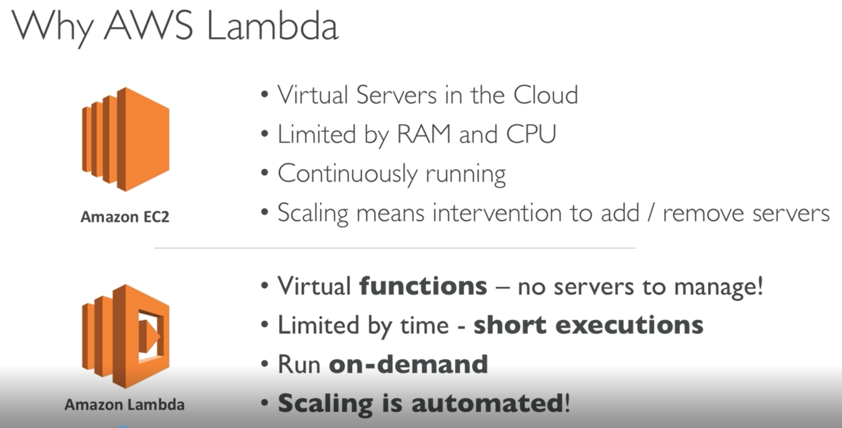
Notes:
https://aws.amazon.com/lambda/features/

Slide 20
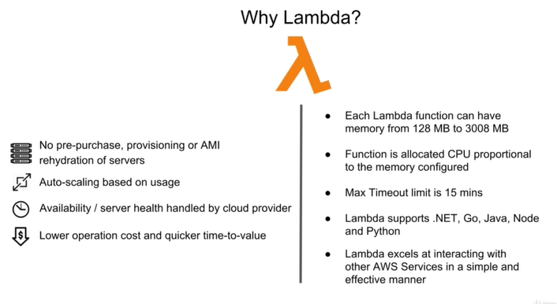
Notes:
Event driven computing using small independent functions running inside containers in cloud.

Slide 21
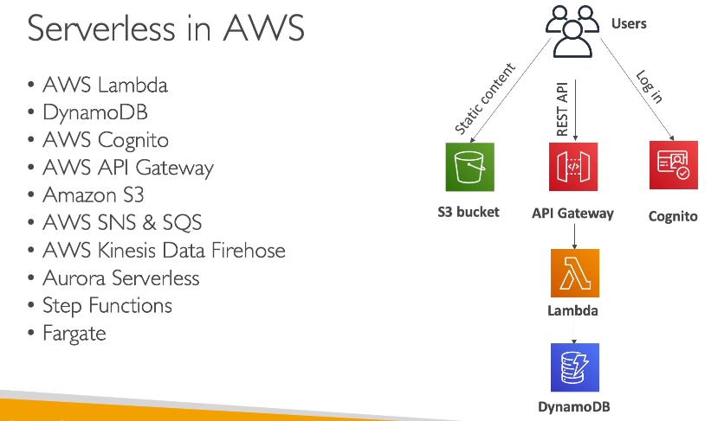

Slide 22
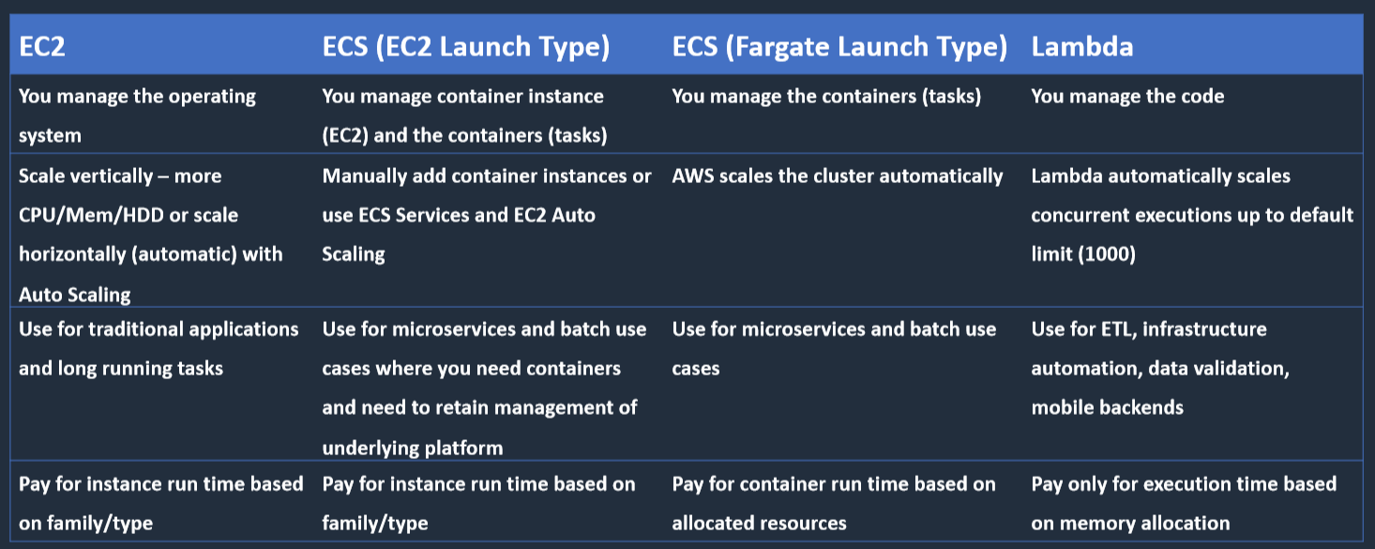

Slide 23
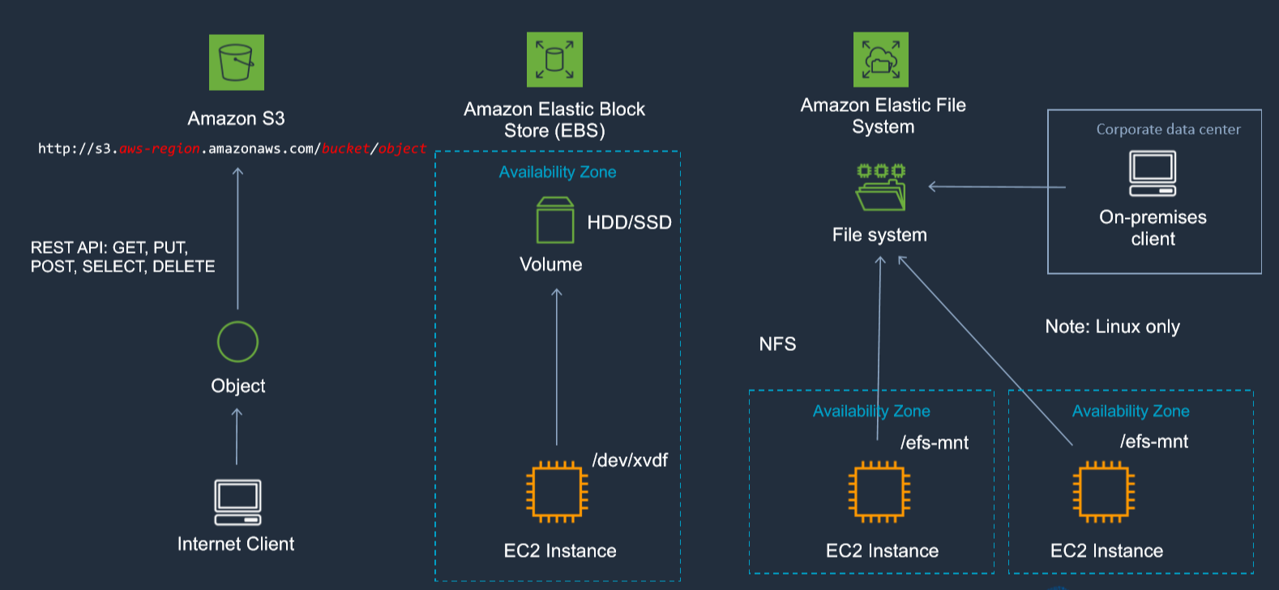
Notes:
Different storage types:
Object Storage
Object-based storage systems manage data as individual objects, rather than as blocks and sectors (block-based) or a file hierarchy (file-based)
Object-based storage is accessed using a REST API (URL with HTTP methods, e.g. GET, PUT)
With object storage data is managed as individual objects rather than a file hierarchy (as with a traditional file system)
Each object includes the data itself, metadata (data about the data), and a globally unique identifier
Due to its flat file structure, object storage has virtually unlimited scalability and allows the retention of massive amounts of unstructured data
Block Storage
Data is stored and managed in blocks within sectors and tracks and is controlled by a server based operating system
Block storage volumes appear as local disks to the operating system and can be partitioned and formatted
You can use block storage devices as a boot volume
Common use cases for block storage are structured information such as file systems, databases, transactional logs, SQL databases and virtual machines (VMs)
File Storage
File-based storage systems manage data in a file hierarchy
A file system is mounted via the network to a client computer where it then becomes accessible for reading and writing data
Protocols used for accessing file systems include NFS or CIFS/SMB

Slide 24
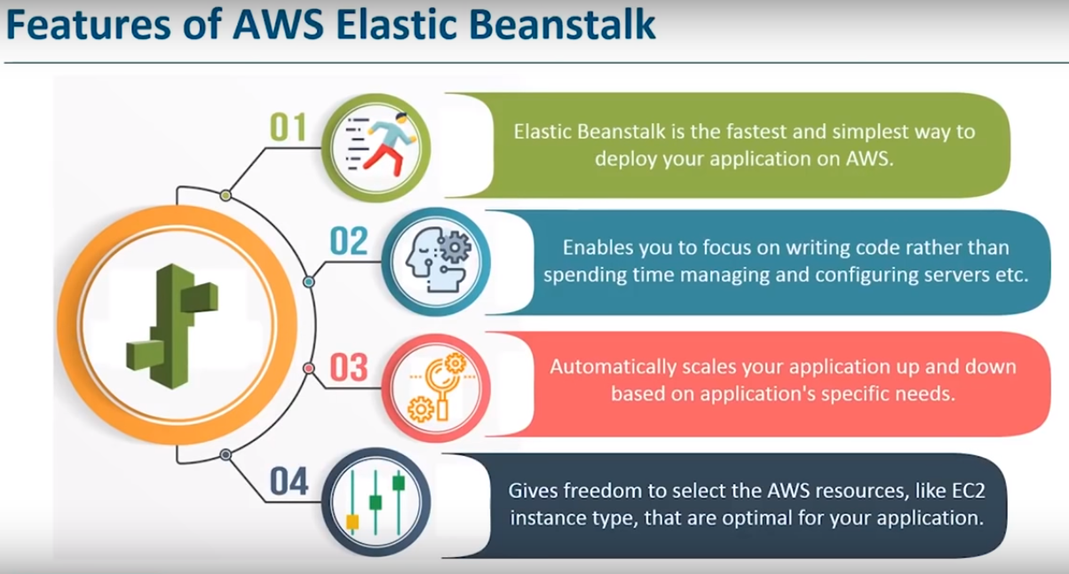
Notes:
https://docs.aws.amazon.com/elasticbeanstalk/latest/dg/GettingStarted.DeployApp.html

Slide 25
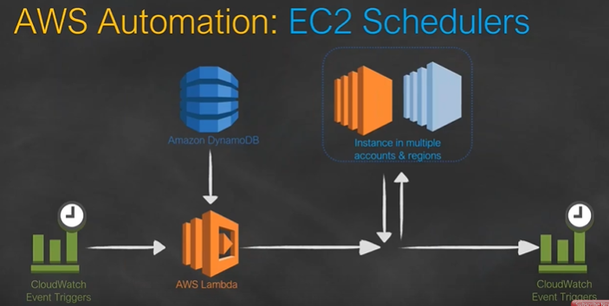
Notes:
https://s3.amazonaws.com/solutions-reference/aws-instance-scheduler/latest/instance-scheduler.template

Slide 26
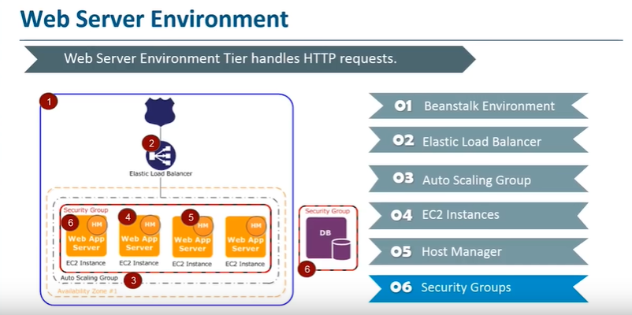
Notes:
Cloud storage means store data in a smart way so that we can get meaningful output from that . Can be used for Big Data ,IOT ,ML ,Robotics etc
EBS has 2 kinds of environment mainly :
Webserver environment
Worker environment

Slide 27
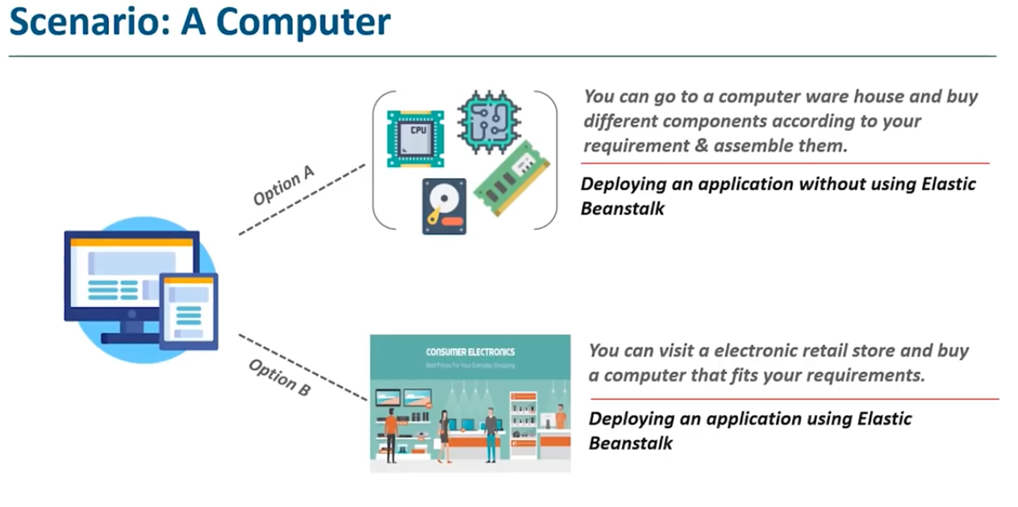
Notes:
EBS is like buying a machine from showroom with your own specifications .Otherwise assemble it yourself .While using EBS you concentrate on your code and other stuffs like installing EC2 instances ,auto scaling groups ,maintaining security ,monitoring etc. is done by AWS .
Infra structure as a service (EC2 API Calls ) → Platform as service (EBS) → Containers (Docker) → Lambda
Lambda = Data center + Hardware + Assembly code /protocol + High level language + OS + Application Layer/AWS API’s + AWS Lambda
Lambda events can triggers another lambda events .Lambda scales out automatically no need to maintain like ELB .Scale up is increasing the amount of hardware .Scale out is when you add more and more instances .
Lambda --→ Create function → Author from Scratch → Run time environment ( C # ,GO1.x ,Java 8 ,Node.js ,Python ) → Policy Template ( Lambda basic execution role but now named as Simple micro service permissions ) → This will allow you to create function
Once function is created → Create trigger → Add trigger ( API Gateway , AWS IoT , Alexa Skills kit ,Cloud front ,cloud watch Event ,Cloud watch log ,code commit ,Cognito Sync Trigger ,Dynamo DB , Kinesis ,s3 , SNS )
In Lambda one set of code will be running across multiple lambda function each serving single HTTP request coming from API gateway .
AWS SDK – These are the API’s which are defined for specific programming language .These are integrated with IDE and used after that .
On eclipse -- > help -- > install new software -- > aws.amazon.com/eclipse -- > select and start using services .

Slide 28
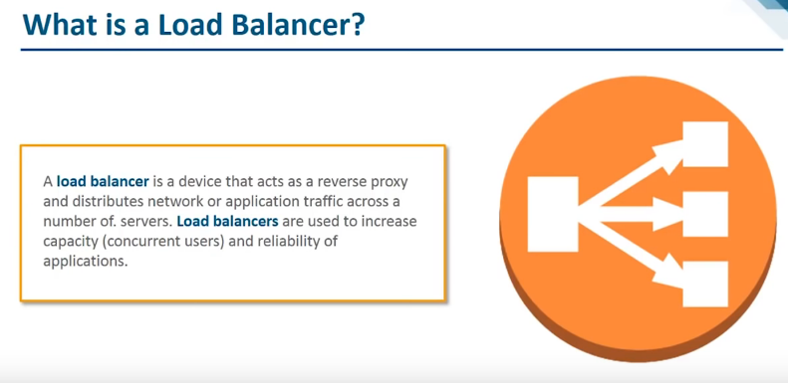
Notes:
Region wide load balancer
Can be used internally and externally
Integrates with Auto scaling ,Amazon cloud watch ,Route53 ,cloud trail .
Multiple SSL certificates require multiple ELB .
#!/bin/bash
yum update -y
yum install httpd -y
service httpd start
chkconfig httpd on
cd /var/www/html
echo "<html><h1>Welcome to web02</h1></html>" > index.html
Classic load balancer (2523) once done check for instances to become active .

Slide 29
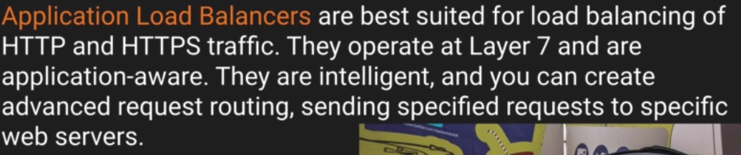
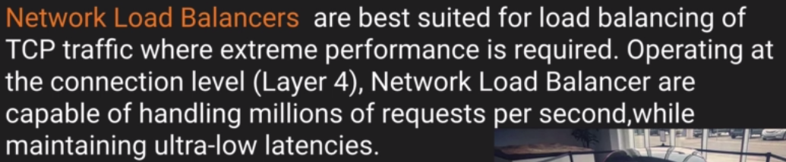
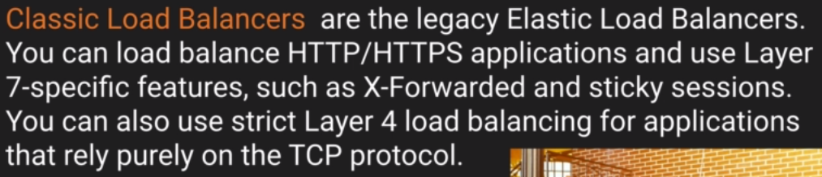
Elastic load Balancers Types :
Notes:
Error 504 means that the application is having issues which could be either at web server level or database layer .You need to identify the application which is failing and scale it up or out which ever is possible .
X-Forwarded-For- header is helpful to get the public IPV4 address from where the request has originated as the ELB will mask them and allow only private IP to communicate with EC2 .
ELB can span across AZ .
Amazon gives ELB a public IP but we can browse via DNS name only .
https://docs.aws.amazon.com/elasticloadbalancing/latest/classic/elb-backend-instances.html
https://docs.aws.amazon.com/elasticloadbalancing/latest/userguide/what-is-load-balancing.html
https://d1.awsstatic.com/whitepapers/architecture/AWS-Operational-Excellence-Pillar.pdf
Error 504 on load balancer means gateway has timed out .Which means application failed to respond within idle time period , Trouble shoot this problem will be in web or database server .

Slide 30
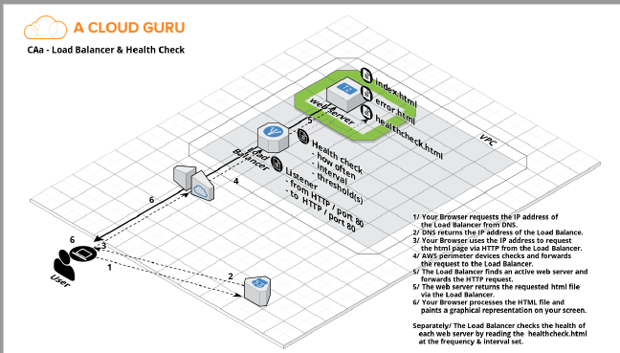
Notes:
Create a LB -- > Listerner HTTP -- > Ping path : /index.html -- > 2 5 2 3 -- > Add EC2 -- >
Once done -- > click on instances to wait for the EC2 to be in Service
Create a target group by instances -- > add your instances to Target -- > Create ALB
Read ELB – FAQ for Certification.

Slide 31
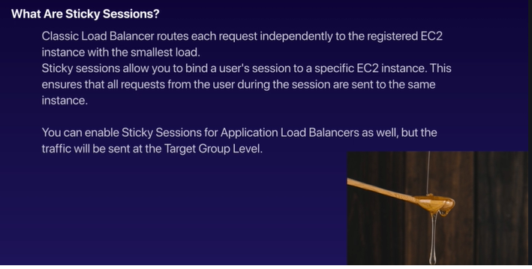
Notes:
Question: If one of your instance is nt receiving any traffic then you have to disable sticky sessions .

Slide 32
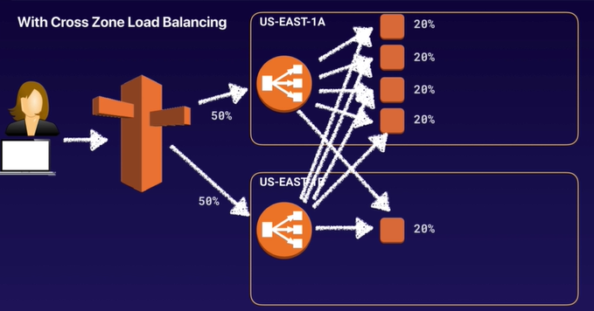
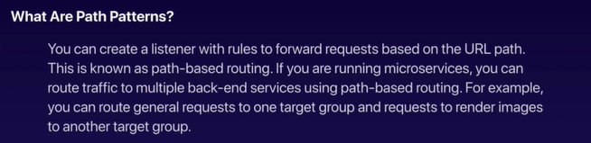

Slide 33
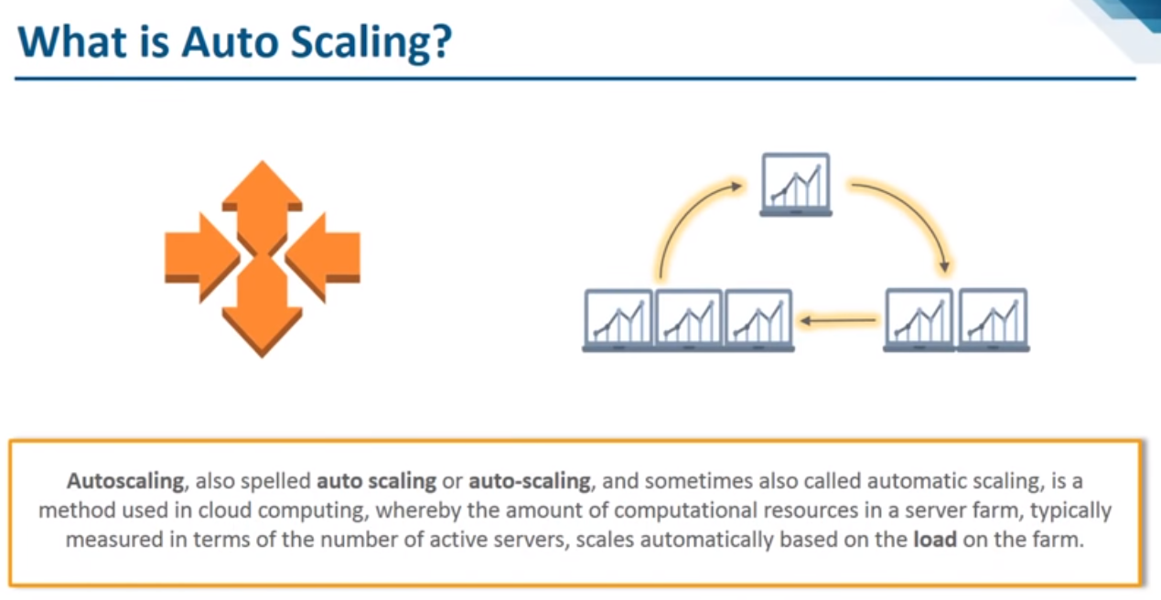
Notes:
There are many clients complaining that the online trading application of an investment bank is always down. Your manager instructed you to re-design the architecture of the application to prevent the unnecessary service interruptions. To ensure high availability, you set up the application to use an ELB to distribute the incoming requests across an auto-scaled group of EC2 instances in two single Availability Zones. In this scenario, what happens when an EC2 instance behind an ELB fails a health check?
https://docs.aws.amazon.com/autoscaling/ec2/userguide/control-access-using-iam.html
Start with Launch configuration

Slide 34
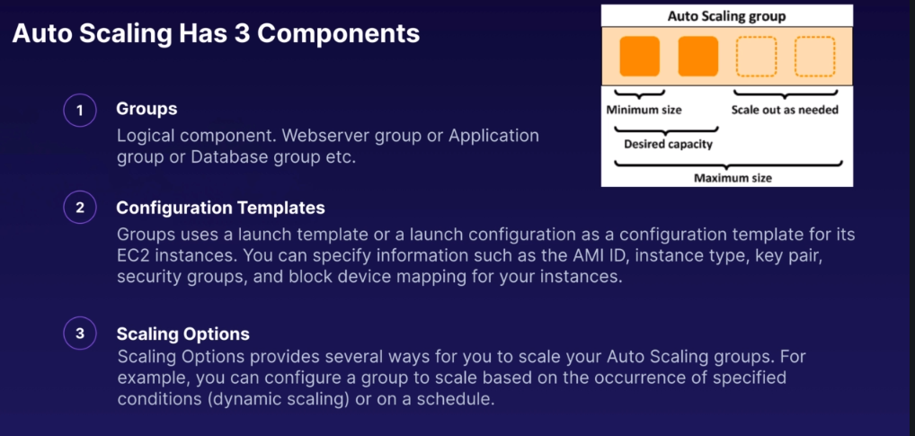

Slide 35
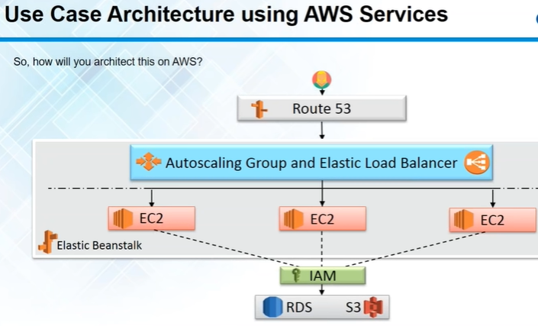
Notes:
SES → domain name -- > verify domain name -- >
Route53 -- > DNS Management -- > create hosted Zone -- > create hosted zone -- >
In freenom -- > use managed name server -- > copy paste from Route53 to freenom -- >
In route53 -- > create record set -- >

Slide 36
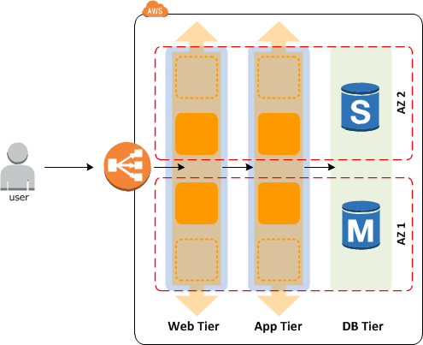
Notes:
In this scenario, the load balancer will route the incoming requests only to the healthy instances. When the load balancer determines that an instance is unhealthy, it stops routing requests to that instance. The load balancer resumes routing requests to the instance when it has been restored to a healthy state.
There are two ways of checking the status of your EC2 instances:
1. Via the Auto Scaling group
2. Via the ELB health checks
The default health checks for an Auto Scaling group are EC2 status checks only. If an instance fails these status checks, the Auto Scaling group considers the instance unhealthy and replaces. If you attached one or more load balancers or target groups to your Auto Scaling group, the group does not, by default, consider an instance unhealthy and replace it if it fails the load balancer health checks.
However, you can optionally configure the Auto Scaling group to use Elastic Load Balancing health checks. This ensures that the group can determine an instance's health based on additional tests provided by the load balancer. The load balancer periodically sends pings, attempts connections, or sends requests to test the EC2 instances. These tests are called health checks.
If you configure the Auto Scaling group to use Elastic Load Balancing health checks, it considers the instance unhealthy if it fails either the EC2 status checks or the load balancer health checks. If you attach multiple load balancers to an Auto Scaling group, all of them must report that the instance is healthy in order for it to consider the instance healthy. If one load balancer reports an instance as unhealthy, the Auto Scaling group replaces the instance, even if other load balancers report it as healthy.

Slide 37
Notes:
Create a SNS topic : Subscribe to it : protocol= Email :End point = email id : create subscription
lambda function to start and stop ec2 instance ::::: https://aws.amazon.com/premiumsupport/knowledge-center/start-stop-lambda-cloudwatch/
If auto scaling is having frequent scale up and down rapidly - Modify scaling group cool down timers & modify the amazon cloud watch alarm period that triggers your auto scaling scale down policy .
You work in the genomics industry and you process large amounts of genomic data using a nightly Elastic Map Reduce (EMR) job. This job processes a single 3 Tb file which is stored on S3. The EMR job runs on 3 on-demand core nodes and four on-demand task nodes. The EMR job is now taking longer than anticipated and you have been asked to advise how to reduced the completion time? – Reduce the input split size in the MR Job configuration and then the numbers of simultaneous mapper task can be processed at once .
service on AWS that is a durable key value store. S3
You are a security architect working for a large antivirus company. The production environment has recently been moved to AWS and is in a public subnet. You are able to view the production environment over HTTP however when your customers try to update their virus definition files over a custom port, that port is blocked. You log in to the console and you allow traffic in over the custom port. How long will this take to take effect? Immediately

